Slide 1

FINANCIAL BARRIERS TO NUTRITION ACCESS IN RURAL TENNESSEE
ANALYZING THE RELATIONSHIP BETWEEN LOW-INCOME COMMUNITIES AND LOW-FOOD ACCESS AREAS
CAROLINE M. BARNES

Slide 2


Slide 3



Slide 4

Food Desert

Slide 5

WHAT IS FOOD INSECURITY?
  Food insecurity is defined as the lack of consistent access to enough food for an active, healthy life (USDA ERS, 2019).
  Includes limited access to fresh, nutritious, and affordable food.
    Urban: >1 mile from a food vendor
    Rural: >10 miles from a food vendor

Slide 6

IS FOOD INSECURITY A CONCERN?
Tennessee:
  14% of Tennessee households experience food insecurity, compared to the national average of 12.5% (U.S. Census Bureau, 2023).
United States:
  Children: Approximately 1 in 5 children in Tennessee live in food-insecure households (Feeding America, 2023).
  18% of Households in rural communities are food Insecure (Rural Health Information, USDA 2023)
Fresh Food Here!
SOLD OUT

Slide 7
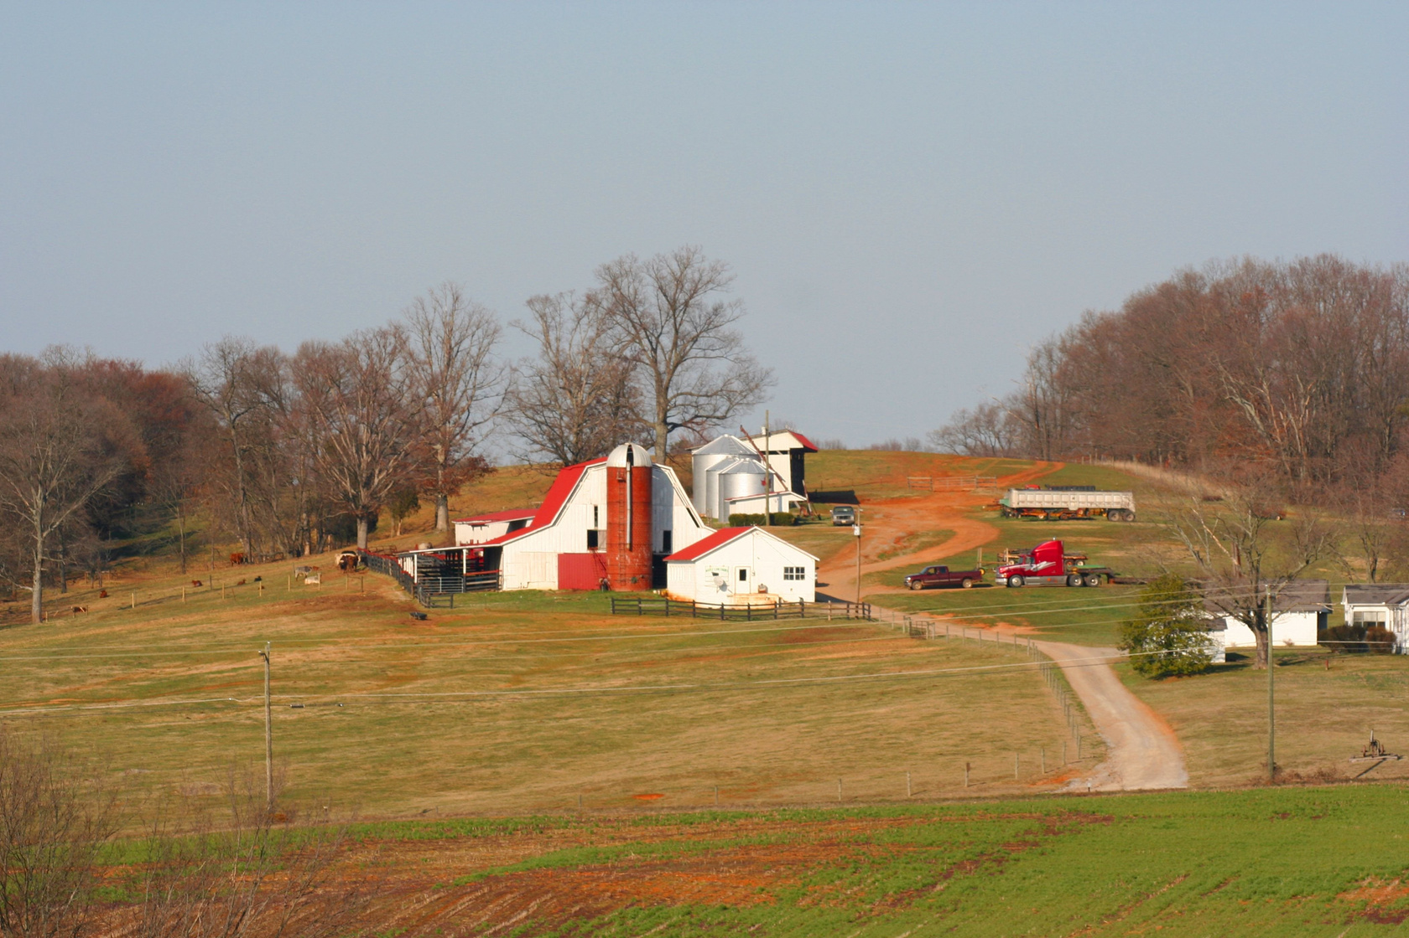
IMPACT ON RURAL TENNESSEE
  Higher rates of obesity, diabetes, and other nutrition-related chronic diseases due to reliance on calorie-dense, nutrient-poor foods (Rural Health Information Hub, 2024).
  Limited grocery stores and fresh food outlets exacerbate access issues in rural areas, particularly in Appalachia and the Mississippi Delta regions.

Slide 8




OBJECTIVES
  Goal 1: Examine financial barriers to nutrition access in rural Tennessee.
  Goal 2: Analyze the effectiveness of current interventions and policies.
  Goal 3: Propose potential financial strategies for improvement.

Slide 9

CONTEXT & BACKGROUND
  Economic Snapshot:
    Tennessee median household income: ~$67,600.
    National median household income: ~$77,700.
    Tennessee poverty rate: 14% vs. national 12.5%.
  Cost of a Healthy Diet:
    World Bank reports 2.5% of Americans can't afford a healthy diet costing $2.63/day.

Slide 10
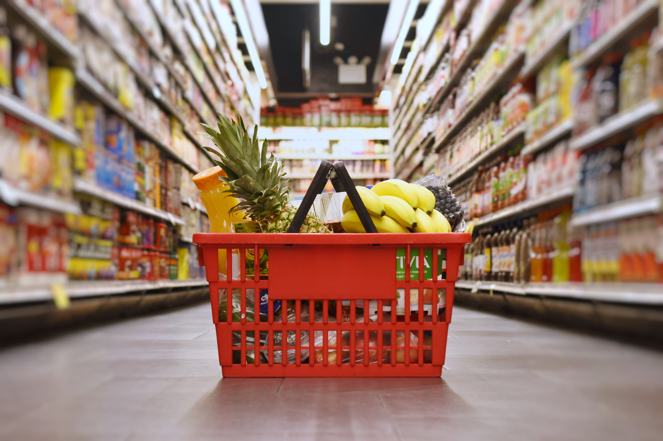
FINANCIAL BARRIERS IN RURAL AREAS
  Higher Cost of Healthy Foods:
    Limited competition and higher prices in rural stores.
  Affordability vs. Processed Foods:
    Cheaper, calorie-dense foods are more accessible.
  Transportation Costs:
    Increased cost of delivering fresh food to rural areas.

Slide 11
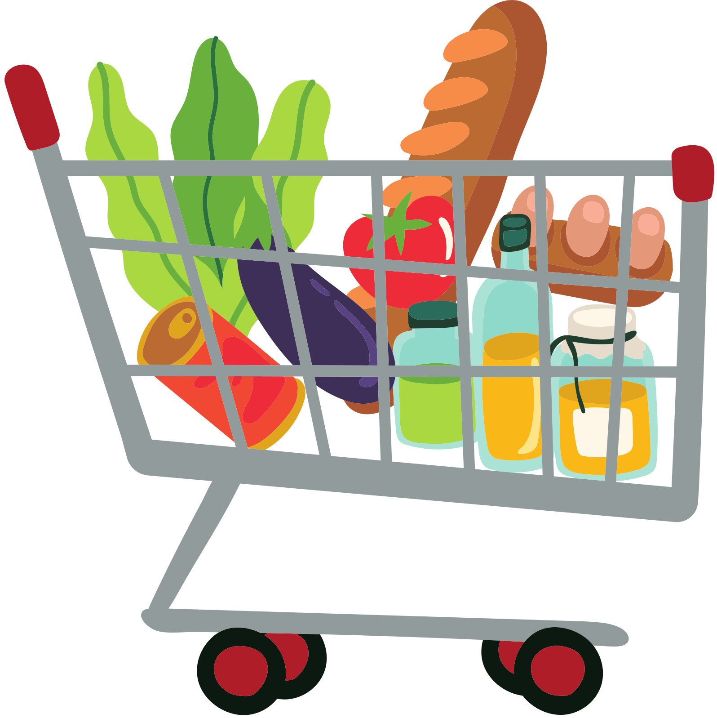
LOW INCOME AND ECONOMIC CONSTRAINTS
Impact on Food Budgets:
  Low-income households prioritize calories over nutrition.
Economic Pressures on Farmers:
  Upfront costs with delayed income until harvest.
Challenges with Government Assistance:
  SNAP and WIC benefits may not cover higher rural food costs.

Slide 12
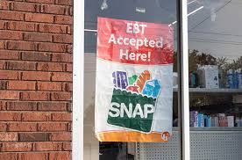
ROLE OF FOOD ASSISTANCE PROGRAMS
  Limited Reach in Rural Areas:
    Few retailers accepting EBT cards.
  Strain on Food Banks:
    Financial and resource limitations.
  Lack of Food Banks:
    Many rural areas lack access entirely.

Slide 13

IMPACT ON PUBLIC HEALTH
  Health Outcomes:
    Higher rates of obesity, diabetes due to poor nutrition.
  Long-Term Consequences:
    Increased healthcare costs.
  Economic productivity losses.
    Cycle of economic disadvantage.

Slide 14

CURRENT SUPPORT STRUCTURES
Federal Programs:
SNAP and WIC serving over 986,000 families.
School Programs:
Title 1 schools providing summer meals and weekend food bags.
Limitations:
Limited access to full-service grocery stores.
Reliance on processed foods.

Slide 15


INNOVATIVE PROGRAMS
  Produce Prescription Programs:
    Example: Appalachian Farmacy.
    Vouchers for fresh produce linked to health care
  Double Up Food Bucks:
    Doubles SNAP benefits at farmers' markets.

Slide 16

EVALUATION OF CURRENT INTERVENTIONS
Effectiveness:
Essential support but limited by reach and funding.
Challenges:
Sustainability issues.
Dependence on grants.
Success Stories:
Positive impacts where programs are implemented.

Slide 17




POTENTIAL FINANCIAL STRATEGIES
  Government Initiatives:
    Expand SNAP and WIC benefits.
    Tax incentives for rural grocery stores and markets.
  Public-Private Partnerships:
    Collaborations to fund food access initiatives.
    Microloans/grants for local farmers.
  Innovative Financial Models:
    Mobile grocery stores.
    Community-Supported Agriculture (CSA).
    Cooperative Food Hubs

Slide 18

FINANCIAL EDUCATION AND EMPOWERMENT
Budgeting for Healthy Food:
Programs teaching financial management.
Financial Literacy:
Empowering better purchasing decisions.
Community Workshops:
Cooking, meal planning, shopping smart.

Slide 19

CONCLUSION
Summary of Findings:
  Financial barriers significantly impact food access.
Need for Innovation:
  Importance of policy reform and new financial models.
Collaboration:
  Cross-sector efforts essential for sustainable solutions.
Recommendations:
  Invest in long-term strategies.
  Further research on sustainable economic models.

Slide 20

QUESTIONS?

